Slide 1


Enriching Ontologies with Disjointness Axioms using Large Language Models
Alessia Pisu, Antonio De Santis, Elias Crum, Jiaxin Pan, Manon Ovide, Nicolas Lazzari,
Sebastian Rudolph
International Semantic Web Summer School 2024

Slide 2
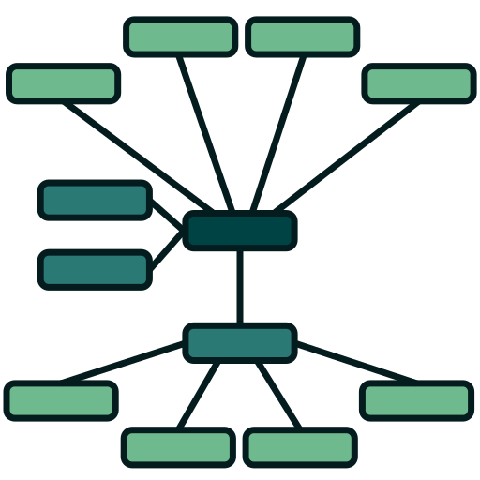




Problem/Introduction
LLM
Ontology
Manual curation of Ontologies
Use LLMs?
Notes:
Manual curation of KGs is a tedious and error-prone endeavor requiring comprehensive domain expertise.

Slide 3








Disjointness
Two classes are considered ”disjoint” if and only if their taxonomic overlap is empty.

Slide 4
Research Questions
Q1: Can LLMs help enrich ontologies with class disjointness axioms?
Q2: Which LLM prompts work better for disjointness discovery?

Slide 5
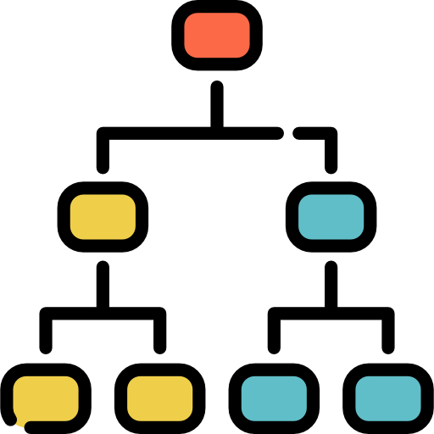
Approach
Disjoint?
A
B
A
B
A
B
Class Relationship Determination
Subclasses must be disjoint

Slide 6




Methodology
Ontological Relationship
A
B
LLMs
A
B

Slide 7


Class Relationships
Negative
Positive
Beauty queen
US president
Sea
Continent

Slide 8
Prompt strategies
Zero-shot naive Can a "Place" be a "Person"? Answer only with “yes” or “no”.
Zero-shot + Task description This is a question about ontological disjointness, answer only with “yes” or “no”. Are the classes "Continent" and "Sea" ontologically disjoint?

Slide 9
Prompt strategies
One-shot + Task description Example of ontological disjointness is Q: Are the classes "Cat" and "Car" ontologically disjoint? A: Yes. """ Please answer the following question only with “yes” or “no”. Q: Are the classes "Basketball Player" and "Baseball Player" ontologically disjoint?
Chain-of-Thought + Task description This is a question about ontological disjointness, final answer only can be “yes” or “no”. Are the classes "Castle" and "Prison" ontologically disjoint? Also, include your reasoning step-by-step.

Slide 10
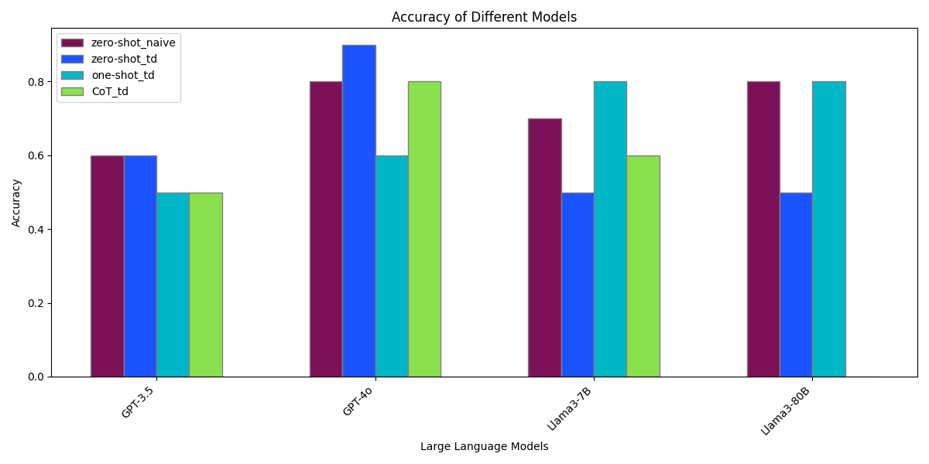
Results:
= no CoT prompt tested
*
*

Slide 11
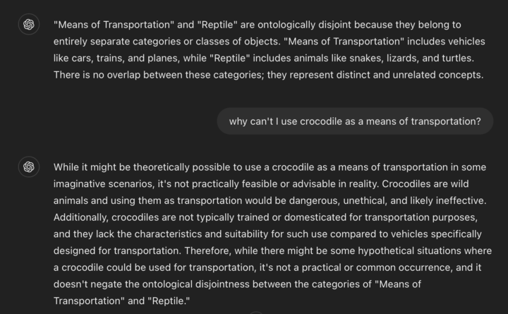
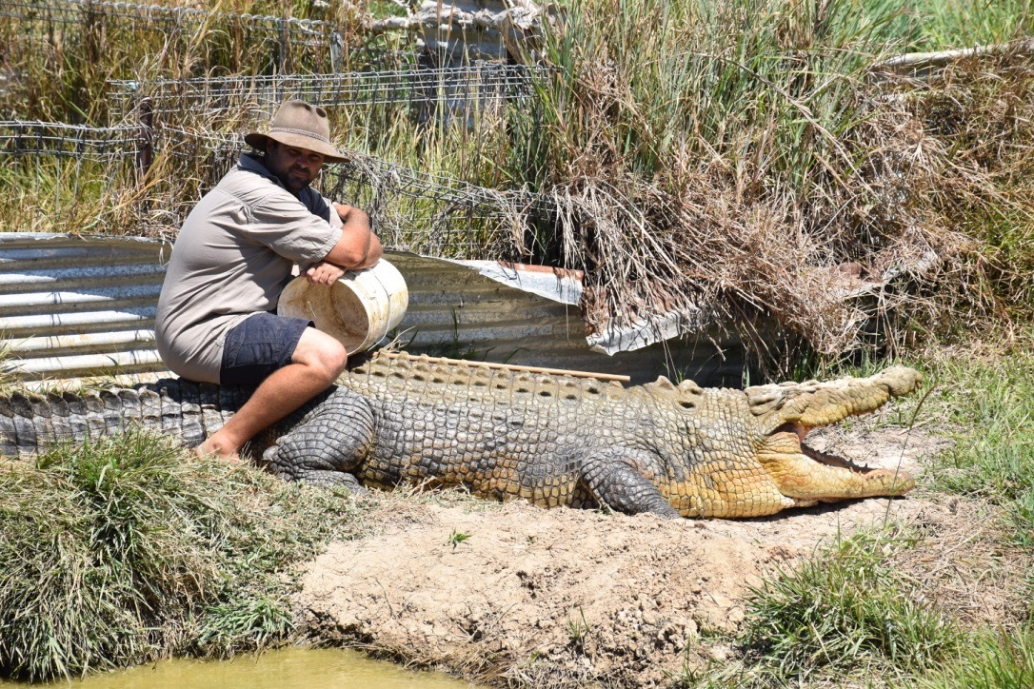
Limitations
Can a "Reptile" be a "Means of Transportation"? Answer only with “yes” or “no”.

Slide 12
Conclusion
LLMs, especially GPT-4o, can identify and assert disjointness axioms in ontologies (relatively well).
Prompt structure and strategy can have a significant impact on the results.
LLMs struggle with some disjointness classifications.
Especially those without discrete real-world examples.

Slide 13

Future Work
Immediate future work:
Assess how LLM classifications are integrated with logical reasoning to minimize LLM prompts needed.
Evaluate the proposed approach on various ontologies, LLMs and a larger dataset.
Involve human domain experts to evaluate the results.
Further enhancements:
Develop heuristics for selecting promising candidate pairs for disjointness.
Explore testing classes with few non-disjoint instances to identify potential errors.
Refine prompts with role descriptions and elements like “at the same time” or “theoretically” for improved responses.

Slide 14
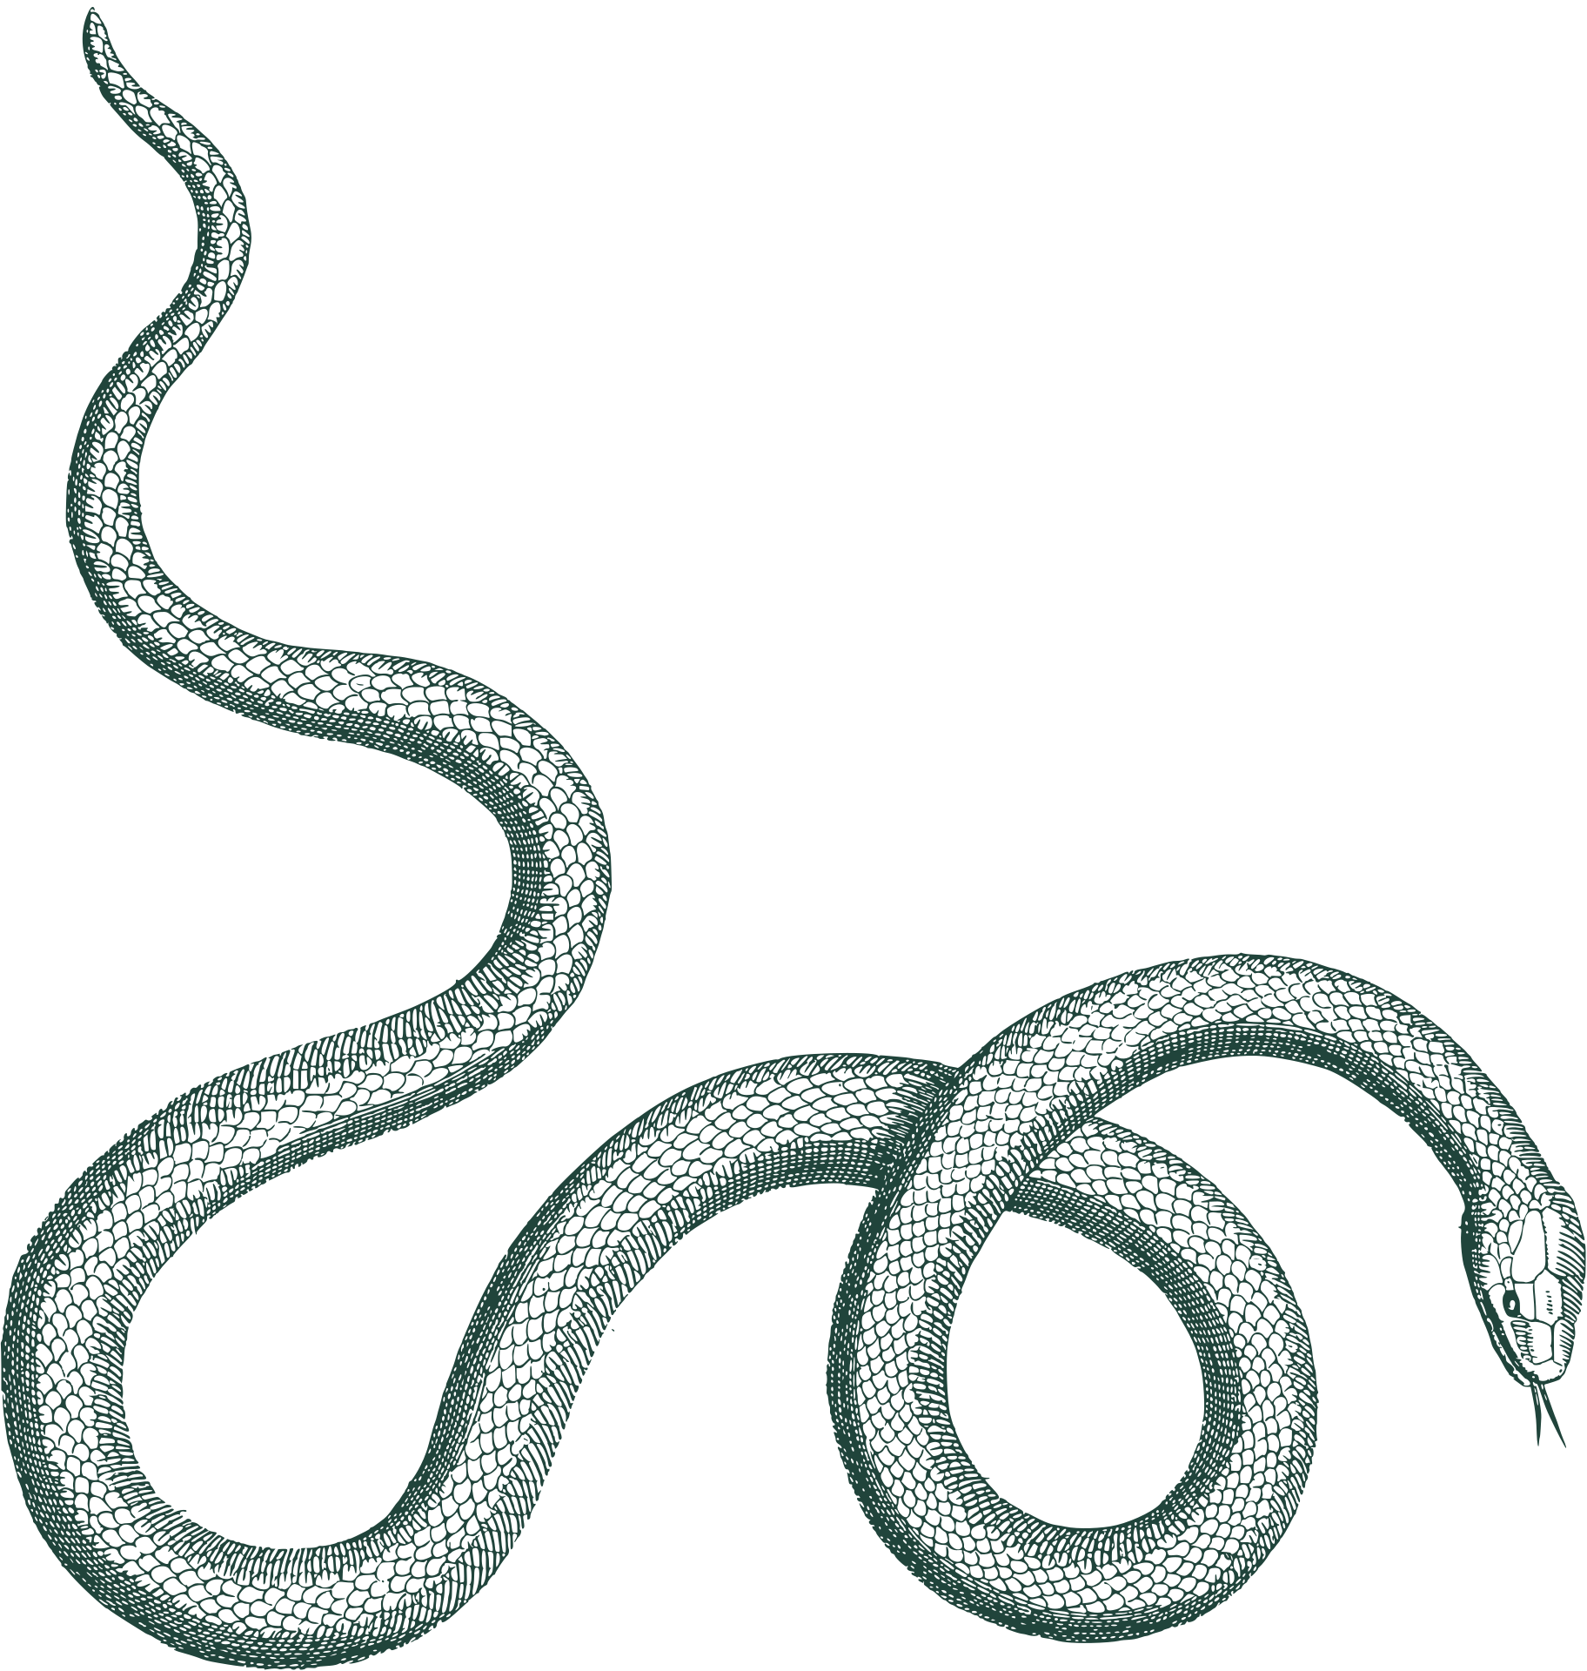


Thank you!

Slide 15
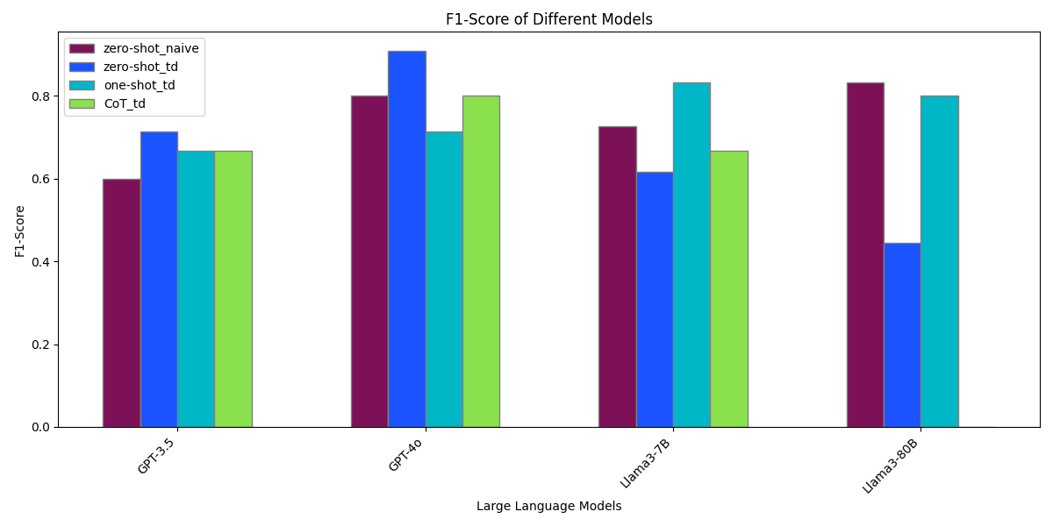
Results: F1-score

Slide 16
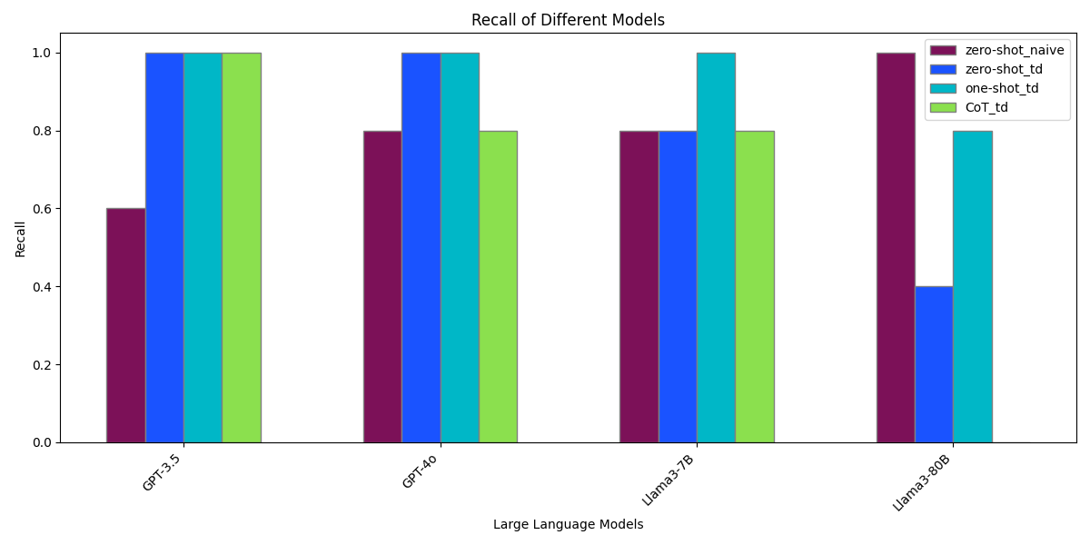
Results: Recall

Slide 17
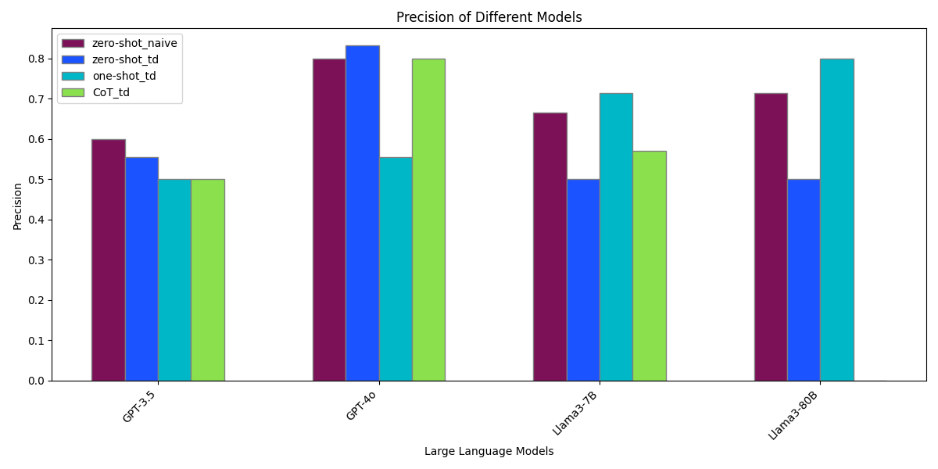
Results: Precision

Slide 18
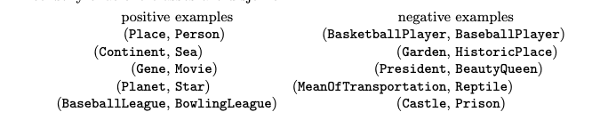
Pairs
in https://DBpedia.org/ontology/

Slide 19
Example
Can a "Reptile" be a "Means of Transportation"? Answer only with “yes” or “no”.
Expected answer: Yes.
GPT3.5 : No. Because reptiles are not typically used as means of transportation.
GPT4o : No. A "Means of Transportation" refers to methods or vehicles used for moving people or goods from one place to another, such as cars, buses, bicycles, planes, etc. A "Reptile" is a type of cold-blooded vertebrate animal that typically has scales and lays eggs, such as snakes, lizards, and turtles. These categories are fundamentally different in nature, with "means of transportation" being a functional category related to travel, and "reptile" being a biological category related to animal classification. Therefore, a reptile cannot be classified as a means of transportation.

